Slide 1
CSC 411: Machine Learning
Lecture 01: Introduction
Bunmi Akinremi
Pan Atlantic University
3rd March, 2026

Slide 2
What we will cover today
Course administration details
Why you should learn ML

Slide 3
Course venue
STT Lab 2
Course prerequisites
Python Programming
Basic probability (Bayes Rule, distributions) and Statistics
Linear Algebra (Vector and Matrix manipulations)
Calculus
Resources
https://github.com/bumie-e/Final-Year-1st-semester-ML-Course/tree/main

Slide 4
Textbooks for the course
Python Machine Learning by Sebastian Raschka & Vahid Mirjalili
Hands-on Machine Learning with Python by Ashwin Pajankar and Aditiya Joshi
Other books for your perusal:
Pattern Recognition and Machine Learning by Christopher M. Bishop.
Machine Learning: A Probabilistic Perspective by Kevin P. Murphy.
The Elements of Statistical Learning by Trevor Hastie, Robert Tibshirani, and Jerome Friedman.
Machine Learning by Tom Mitchell.

Slide 5
Course Expectations:
Before each class, the reading materials have been studied. If necessary, code exercises have been done.
All assignments are submitted at the beginning of the next class.
Collaboration on assignments is not allowed.
Labs are designed to be collaborative and engaging and to be done during the class.
Each completed lab contributes to the participatory mark

Slide 6
Teaching Format
Lectures: Conceptual framing + intuition
Labs: Hands-on notebooks (JupyterLab, VSCode, Google Colab)
Case studies: Real industry scenarios
In-class discussions: Trade-offs, failures, ethics
Grading Structure
Weekly labs/assignments: 10 marks
Mid-semester applied assessment: 10 marks
Final project (team-based): 15 marks
Participation & engagement: 5 marks
Exams 65 marks

Slide 7
Resources
Lecture notes, assignments, reading materials are also available on the page here:
https://github.com/bumie-e/Final-Year-1st-semester-ML-Course/tree/main
Office Hours
1hr/week
TBD exactly when

Slide 8
Course Schedules
Weeks | Topic | Assignment
1 | What Machine Learning Really Is (and Is Not)
2 | Data: The Real Bottleneck
3 | Features Matter More Than Models
4 | Linear Models and Optimisation | Asst1
5 | Non-Parametric Models and Decision Trees
6 | Mid term Assessment
7 | Model Selection, Evaluation, and Learning Theory
Weeks | Topic | Assignment
8 | Support Vector Machines (SVMs) and Kernel Methods
9 | Unsupervised Learning I (Clustering & Dimensionality Reduction)
10 | Reinforcement Learning | Asst2
11 | Model Selection and Hyperparameter Tuning
12 | MLOps, Big Data, and Deployment

Slide 9
Part I: Foundations and Classical Supervised Learning
What Machine Learning Really Is (and Is Not)
What is Machine Learning?
Machine learning is the technology of developing computer algorithms that are able to emulate human intelligence. El Naqa, I., Murphy, M.J. (2015)

Slide 10
Part I: Foundations and Classical Supervised Learning
What Machine Learning Really Is (and Is Not)
What is Machine Learning?
Machine learning is the technology of developing computer algorithms that are able to emulate human intelligence. El Naqa, I., Murphy, M.J. (2015)
A computer program is said to learn from experience E with respect to some class of tasks T and performance measure P, if its performance at tasks in T, as measured by P, improves with experience E. TM Mitchell (1997)

Slide 11
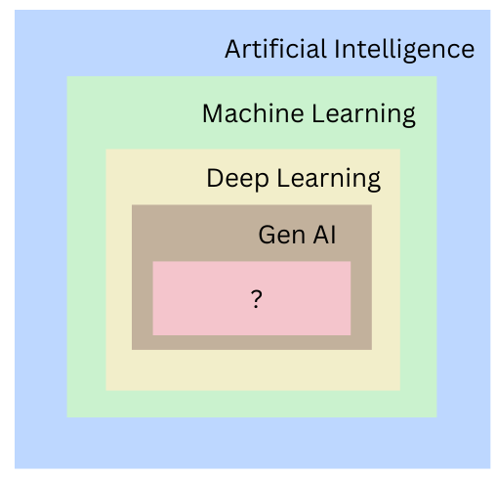
Part I: Foundations and Classical Supervised Learning
What Machine Learning Really Is (and Is Not)
What is Machine Learning?
Machine learning is the technology of developing computer algorithms that are able to emulate human intelligence. El Naqa, I., Murphy, M.J. (2015)
A computer program is said to learn from experience E with respect to some class of tasks T and performance measure P, if its performance at tasks in T, as measured by P, improves with experience E. TM Mitchell (1997)

Slide 12
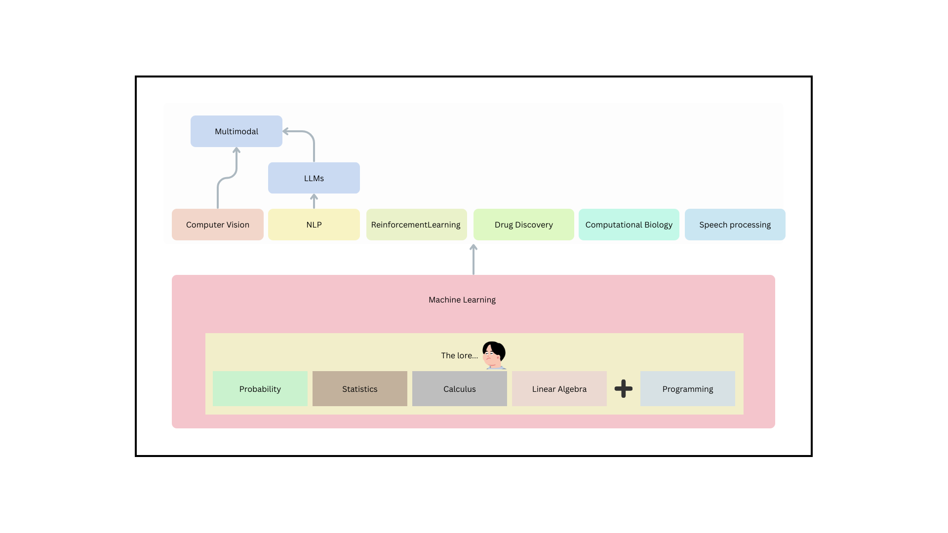
Part I: Foundations and Classical Supervised Learning
What is Machine Learning?

Slide 13
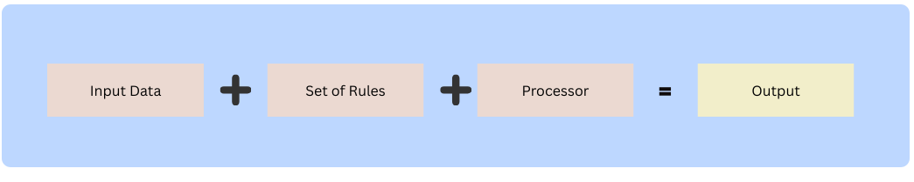
Part I: Foundations and Classical Supervised Learning
ML vs. Traditional Rule-Based Systems
Typical software development

Slide 14
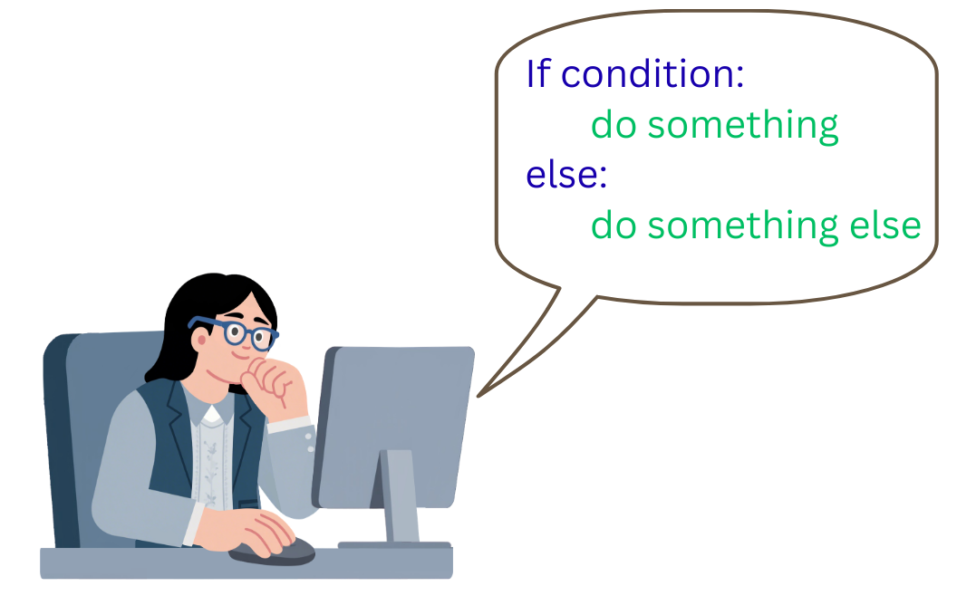
Part I: Foundations and Classical Supervised Learning
ML vs. Traditional Rule-Based Systems
Typical software development

Slide 15
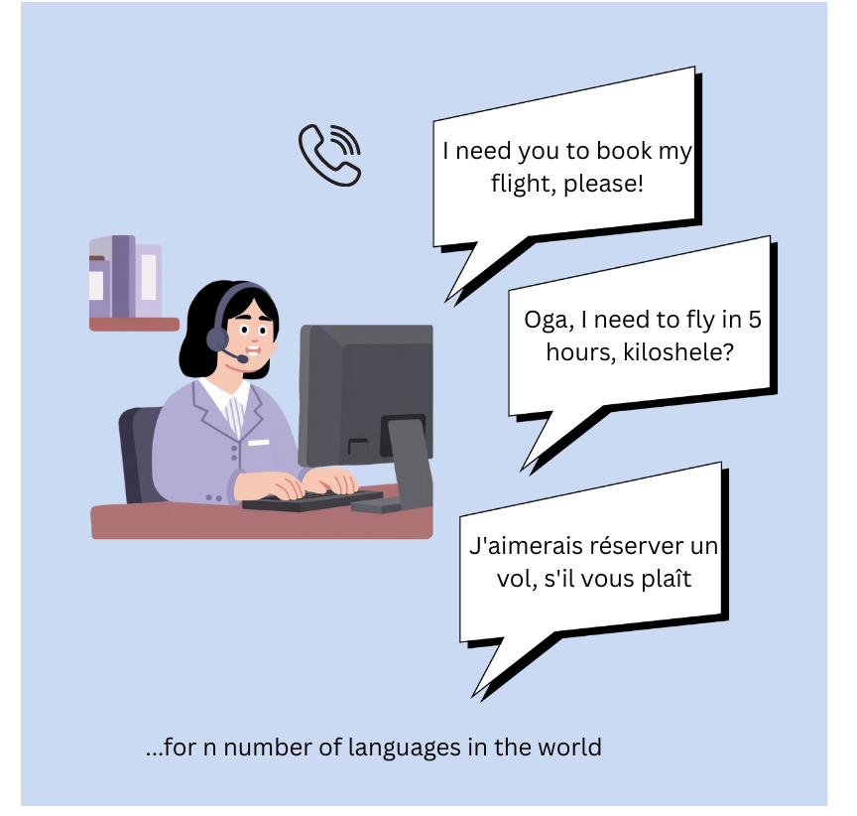
Part I: Foundations and Classical Supervised Learning
ML vs. Traditional Rule-Based Systems
Typical software

Slide 16
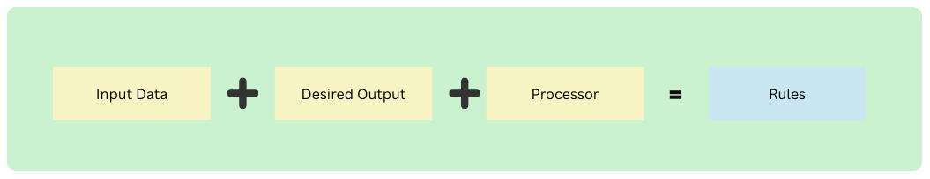
Part I: Foundations and Classical Supervised Learning
ML vs. Traditional Rule-Based Systems
Machine Learning
We do not explicitly program the logic; the machine learns the mapping function f(x) to predict y from x

Slide 17
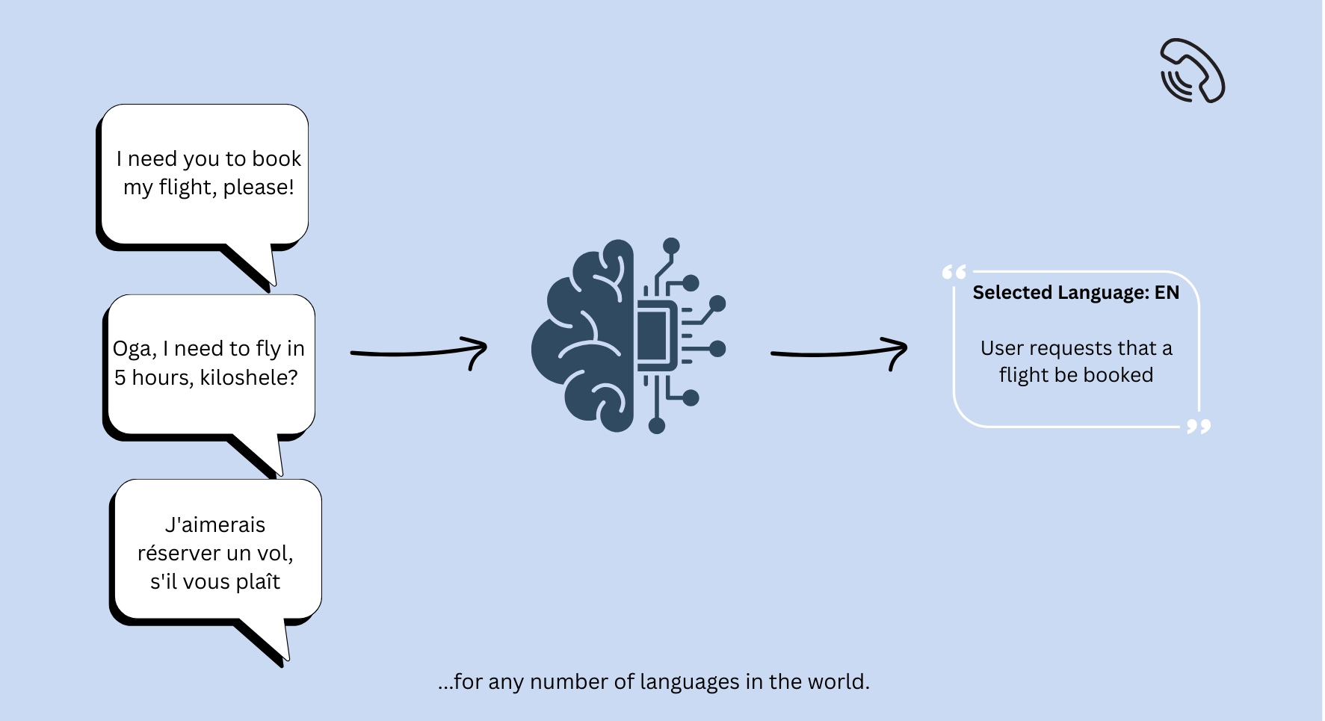
Part I: Foundations and Classical Supervised Learning
ML vs. Traditional Rule-Based Systems
Machine Learning

Slide 18
Part I: Foundations and Classical Supervised Learning
ML vs. Traditional Rule-Based Systems
Why use Machine Learning?
Handling Big Data & Complexity: ML algorithms can analyze massive amounts of data and identify patterns too complex or vast for human analysis.
Automation of Tasks: It automates repetitive, low-cognition tasks, freeing up human resources for more strategic work.
Improved Accuracy & Decision Making: By learning from data, models improve their own performance, leading to more precise predictions.
Personalization: ML powers recommendation engines, allowing companies to offer tailored experiences to users, such as those on Netflix or Amazon.

Slide 19
Part I: Foundations and Classical Supervised Learning
ML vs. Traditional Rule-Based Systems
When to not use Machine Learning?
Clear Analytical Solutions: If a problem can be solved with a simple mathematical formula (e.g., calculating payroll, basic physics simulations) or software techniques.
No Data Available: ML is data-hungry; without relevant experience E, learning cannot occur.
100% Accuracy Required: ML is probabilistic; it makes errors. It is unsuitable for systems where a single error is catastrophic and deterministic rules exist. Think of an AI Pilot…

Slide 20
Part I: Foundations and Classical Supervised Learning
Machine learning paradigms
Supervised Learning
Unsupervised Learning
Reinforcement Learning
Semi-Supervised Learning
Deep Learning
Active Learning
Online Learning
Transfer Learning

Slide 21
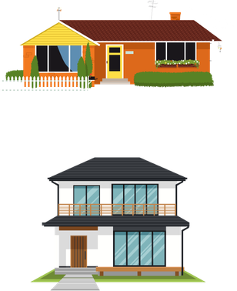
Part I: Foundations and Classical Supervised Learning
Machine learning paradigms
Supervised Learning
Unsupervised Learning
Reinforcement Learning
Semi-Supervised Learning
Deep Learning
Active Learning
Online Learning
Transfer Learning
Here, the model learns from a set of inputs and known outputs. This input-output set is known as labelled data
Goal:
To train a predictive model that learns patterns from this data set, and use it to predict the output of an unseen input
Type | Size | Price
Bungalow | 600 by 700 | 1.2 M
Duplex | 800 by 900 | 4 M

Slide 22
Part I: Foundations and Classical Supervised Learning
Machine learning paradigms
Supervised Learning
Unsupervised Learning
Reinforcement Learning
Semi-Supervised Learning
Deep Learning
Active Learning
Online Learning
Transfer Learning
Here, the model learns from a set of inputs and known outputs. This input-output set is known as labelled data
Goal:
To train a predictive model that learns patterns from this data set, and use it to predict the output of an unseen input
Type | Size | Price
Bungalow | 600 by 700 | 1.2 M
Duplex | 800 by 900 | 4 M
Can we build a model, that takes inputs x₁ and x₂, and gives an output/prediction y?
y ≈ f(x) = m₁x₁ + m₂x₂ + c
Where m is the weight.
c is the bias

Slide 23
Part I: Foundations and Classical Supervised Learning
Machine learning paradigms
Supervised Learning
Unsupervised Learning
Reinforcement Learning
Semi-Supervised Learning
Deep Learning
Active Learning
Online Learning
Transfer Learning
y ≈ f(x) = Predict(x₁, x₂, x₃,...x_{n})
Given that, Predict has already been trained on the set
y₁ = x₁ + z₁
y₂ = x₂ + z₂
y₃ = x₃ + z₃
Can we predict the value of y₄, given that we have data points x₃ + z₃ ?
Think of:
House prices, given location and development type (urban vs rural)
Dog breed, given Picture and behaviour
Nationality, given Language and Favourite food
Can we build a model, that takes inputs x₁ and x₂, and gives an output/prediction y?
y ≈ f(x) = m₁x₁ + m₂x₂ + c
Where m is the weight.
c is the bias

Slide 24
Part I: Foundations and Classical Supervised Learning
Machine learning paradigms
What other examples can you think of?

Slide 25
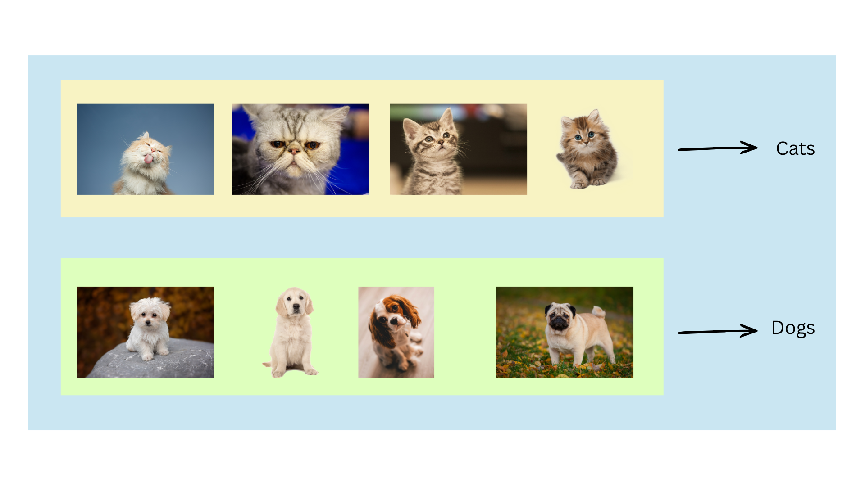
Part I: Foundations and Classical Supervised Learning
Machine learning paradigms
Supervised Learning
Unsupervised Learning
Reinforcement Learning
Semi-Supervised Learning
Deep Learning
Active Learning
Online Learning
Transfer Learning
Classification
Works with discrete categories or classes. These categories are finite.
y([0,1,...]) = wx₁ + wx₂ + wx₃ +...

Slide 26
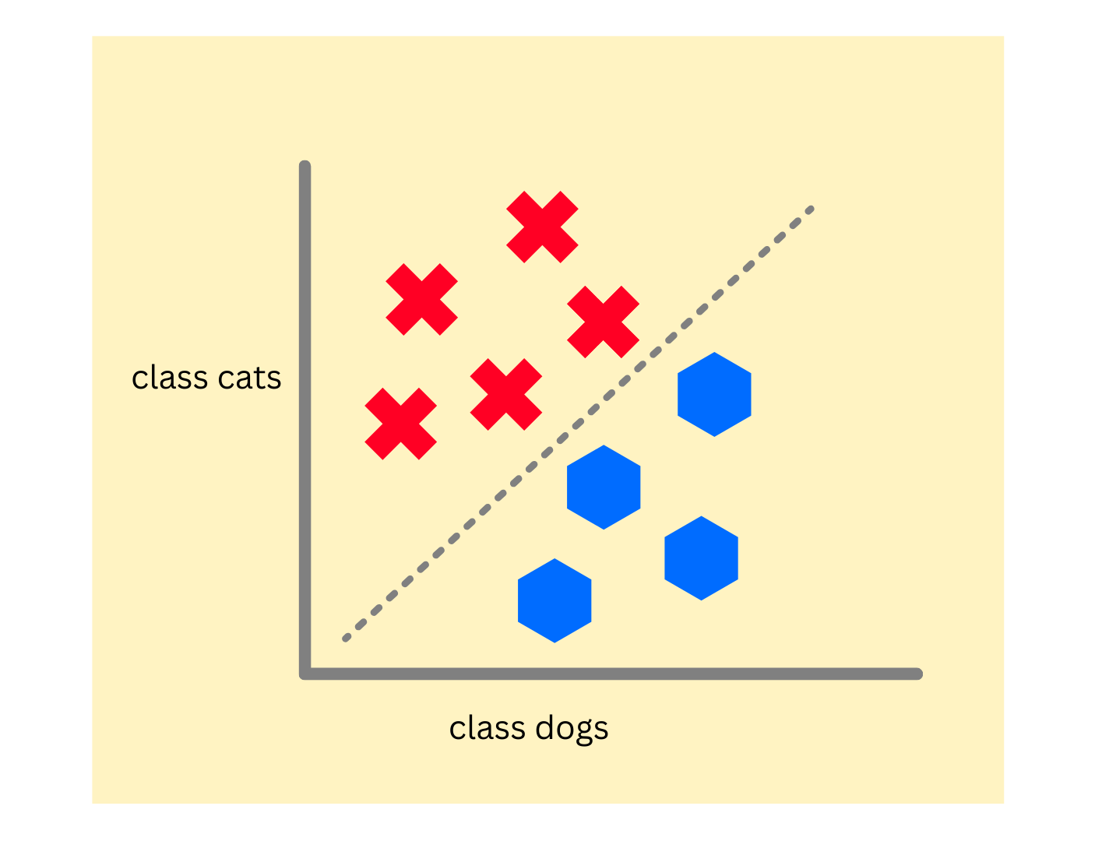
Part I: Foundations and Classical Supervised Learning
Machine learning paradigms
Supervised Learning
Unsupervised Learning
Reinforcement Learning
Semi-Supervised Learning
Deep Learning
Active Learning
Online Learning
Transfer Learning
Classification
Binary classification, involving two classes
Multi-class classification, involving more than 2 classes

Slide 27
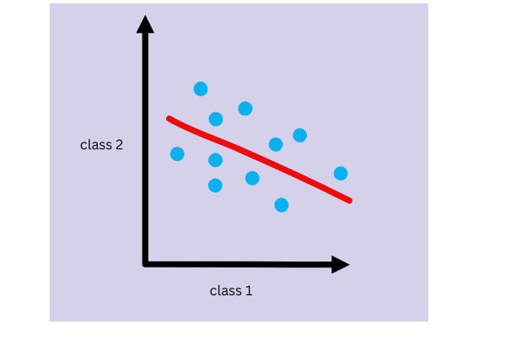
Part I: Foundations and Classical Supervised Learning
Machine learning paradigms
Supervised Learning
Unsupervised Learning
Reinforcement Learning
Semi-Supervised Learning
Deep Learning
Active Learning
Online Learning
Transfer Learning
Regression
Predicts continuous variables. Cannot be categorised because it’d be infinite.
For example, consider the prices of cars in Lagos
y([34.5, 15.2, 33.4]) = wx₁ + wx₂ + wx₃ +... + wx_{n}
Where n e R

Slide 28

Part I: Foundations and Classical Supervised Learning
Machine learning paradigms
Supervised Learning
Unsupervised Learning
Reinforcement Learning
Semi-Supervised Learning
Deep Learning
Active Learning
Online Learning
Transfer Learning
How does the model know if it’s approximating right?
Through a loss function!
A loss function calculates how much a model’s current subset of outputs deviates from the ground truth while training.
For instance,
Ground truth = 10.3, 2.3, 5.6
Current prediction = 9, 4.1, 3.4
Value of loss = ?
Model Goal:
To minimise loss
MAE, MSE, Cross Entropy,

Slide 29
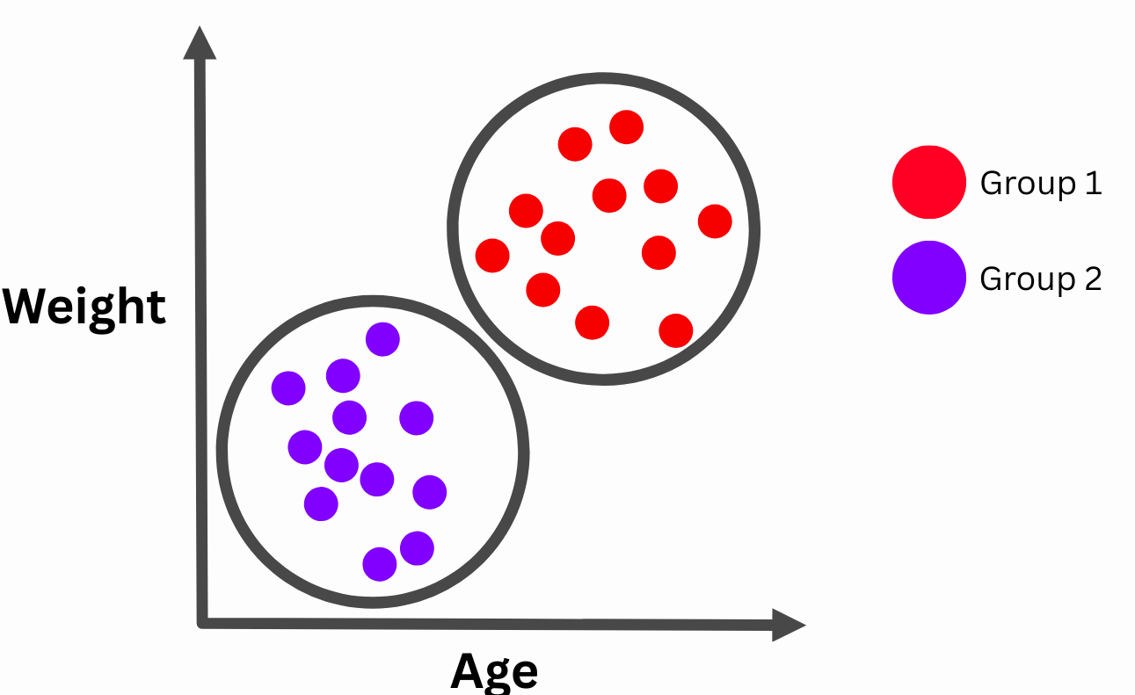
Part I: Foundations and Classical Supervised Learning
Machine learning paradigms
Supervised Learning
Unsupervised Learning
Reinforcement Learning
Semi-Supervised Learning
Deep Learning
Active Learning
Online Learning
Transfer Learning
Discover underlying structure in a collection of entirely unlabeled data. Only input features x are provided; there are no y labels.
Useful in finding similarities, correlations, or clusters.
Goal:
To explore patterns, discover hidden features, compress data, or group similar items without explicit labelling
Because unsupervised learning does not acknowledge labels, they don’t require loss functions.

Slide 30
Part I: Foundations and Classical Supervised Learning
Machine learning paradigms
Supervised Learning
Unsupervised Learning
Reinforcement Learning
Semi-Supervised Learning
Deep Learning
Active Learning
Online Learning
Transfer Learning
Common Clustering Algorithms
Anomaly Detection
Clustering
Dimensionality Reduction
Association Rule Mining

Slide 31
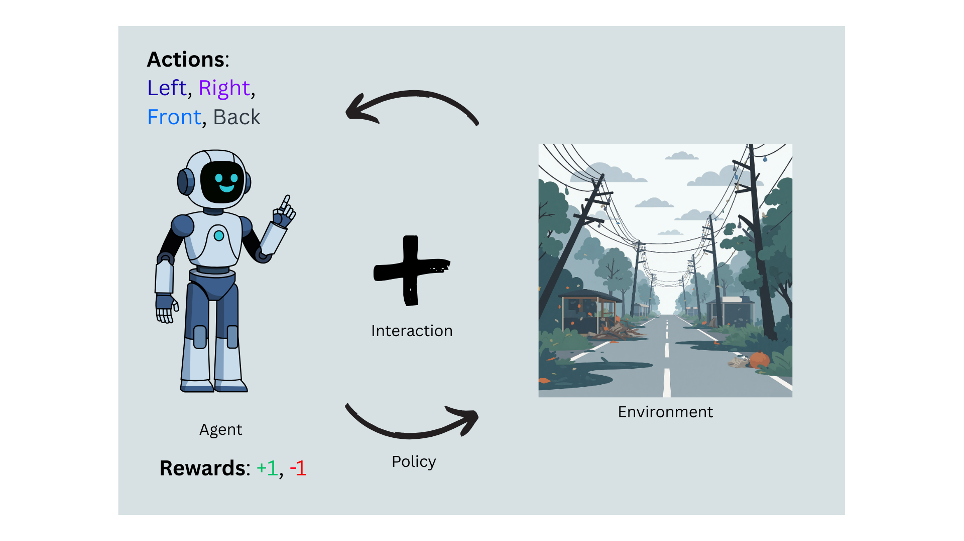
Part I: Foundations and Classical Supervised Learning
Machine learning paradigms
Supervised Learning
Unsupervised Learning
Reinforcement Learning
Semi-Supervised Learning
Deep Learning
Active Learning
Online Learning
Transfer Learning
Teaching agents to learn by trial and error.
Rather than gather a bunch of data to train, data is gotten through interaction with the environment and feedback

Slide 32
Part I: Foundations and Classical Supervised Learning
Machine learning paradigms
Supervised Learning
Unsupervised Learning
Reinforcement Learning
Semi-Supervised Learning
Deep Learning
Active Learning
Online Learning
Transfer Learning
Can be categorised into:
Model-based RL
Model-free RL

Slide 33
Part I: Foundations and Classical Supervised Learning
Machine learning paradigms
Supervised Learning
Unsupervised Learning
Reinforcement Learning
Semi-Supervised Learning
Deep Learning
Active Learning
Online Learning
Transfer Learning
Like supervised learning, some parts of the data contain labels, while the other part doesn’t
The goal is still the same, to learn from both. In real world, it is often impractical to label millions of data points
Can be:
Inductive (learning a general model)
Transductive (predicting only the specific unlabeled instances)

Slide 34
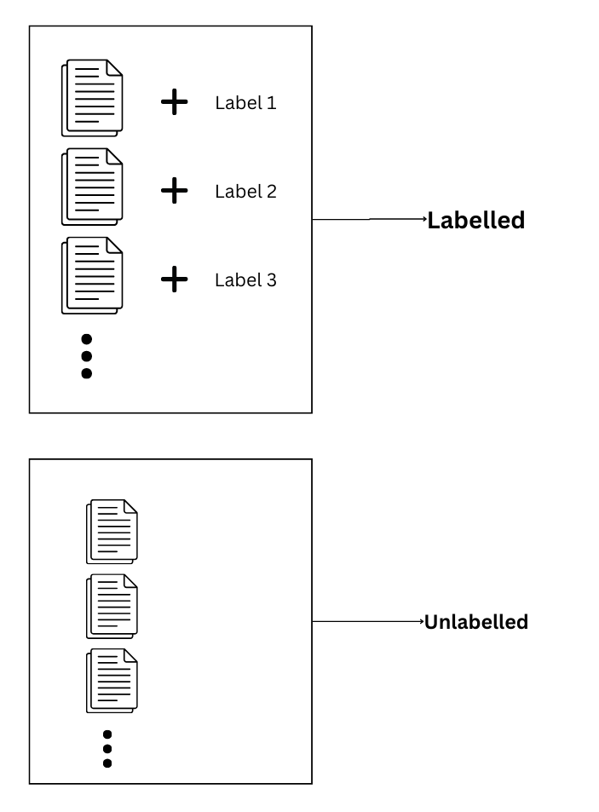
Part I: Foundations and Classical Supervised Learning
Machine learning paradigms
Supervised Learning
Unsupervised Learning
Reinforcement Learning
Semi-Supervised Learning
Deep Learning
Active Learning
Online Learning
Transfer Learning
Like supervised learning, some parts of the data contain labels, while the other part doesn’t
The goal is still the same, to learn from both. In real world, it is often impractical to label millions of data points
Can be:
Inductive (learning a general model)
Transductive (predicting only the specific unlabeled instances)
Like with LLM models today, you’d label a small subset, train a classification model then use it to label the rest

Slide 35
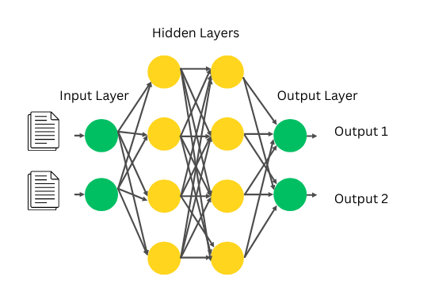
Part I: Foundations and Classical Supervised Learning
Machine learning paradigms
Supervised Learning
Unsupervised Learning
Reinforcement Learning
Semi-Supervised Learning
Deep Learning
Active Learning
Online Learning
Transfer Learning
Inspired by the human brain, the idea of interconnected processing layers, with its own mathematical function (activation), where the output of one layer is input to the other until the final layer.
Through backpropagation, the model can determine the contribution of each node to the loss function by adjusting the weights!

Slide 36
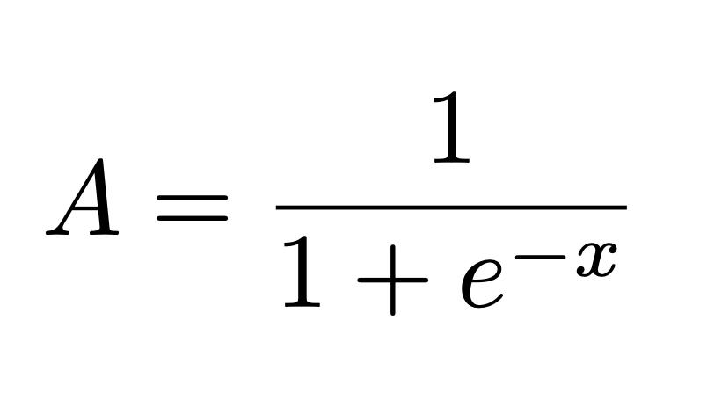
Part I: Foundations and Classical Supervised Learning
Machine learning paradigms
Supervised Learning
Unsupervised Learning
Reinforcement Learning
Semi-Supervised Learning
Deep Learning
Active Learning
Online Learning
Transfer Learning
Activation Function:
A mathematical function that is applied to the output of a neuron.
Helps introduces non linearity into models.
There are several types, but 3 are most common, Sigmoid, Softmax, and Relu
Sigmoid Function,

Slide 37
Part I: Foundations and Classical Supervised Learning
Machine learning paradigms
Supervised Learning
Unsupervised Learning
Reinforcement Learning
Semi-Supervised Learning
Deep Learning
Active Learning
Online Learning
Transfer Learning
Teaching by learning as you go…
Here,
the model selectively chooses the most informative, unlabeled data points to be labeled by a human annotator (the "oracle") or computer program,
with the goal of achieving high accuracy with a smaller amount of labeled data,
thereby saving significant time and cost associated with manual annotation

Slide 38
Part I: Foundations and Classical Supervised Learning
Machine learning paradigms
Supervised Learning
Unsupervised Learning
Reinforcement Learning
Semi-Supervised Learning
Deep Learning
Active Learning
Online Learning
Transfer Learning
How it works:
Initialise with a “seed” set to train an initial model
Model predicts on the set of unlabelled data and adds an uncertainty score
A “query” strategy selects the most valuable data points from the pool for review by the human
Teaching by learning as you go…
Here,
the model selectively chooses the most informative, unlabeled data points to be labeled by a human annotator (the "oracle") or computer program,
with the goal of achieving high accuracy with a smaller amount of labeled data,
thereby saving significant time and cost associated with manual annotation
Human expert labels the selected data points
This is added back to the existing training set, and retrained.

Slide 39
Part I: Foundations and Classical Supervised Learning
Machine learning paradigms
Supervised Learning
Unsupervised Learning
Reinforcement Learning
Semi-Supervised Learning
Deep Learning
Active Learning
Online Learning
Transfer Learning
Training models using stream of data chunks.
However not, every model can learn online. Models that use a continuous optimisation produce can use online learning For instance, neural networks
Updates the model based on new information. Think of stocks, forex trading models…
Avoids retraining!

Slide 40
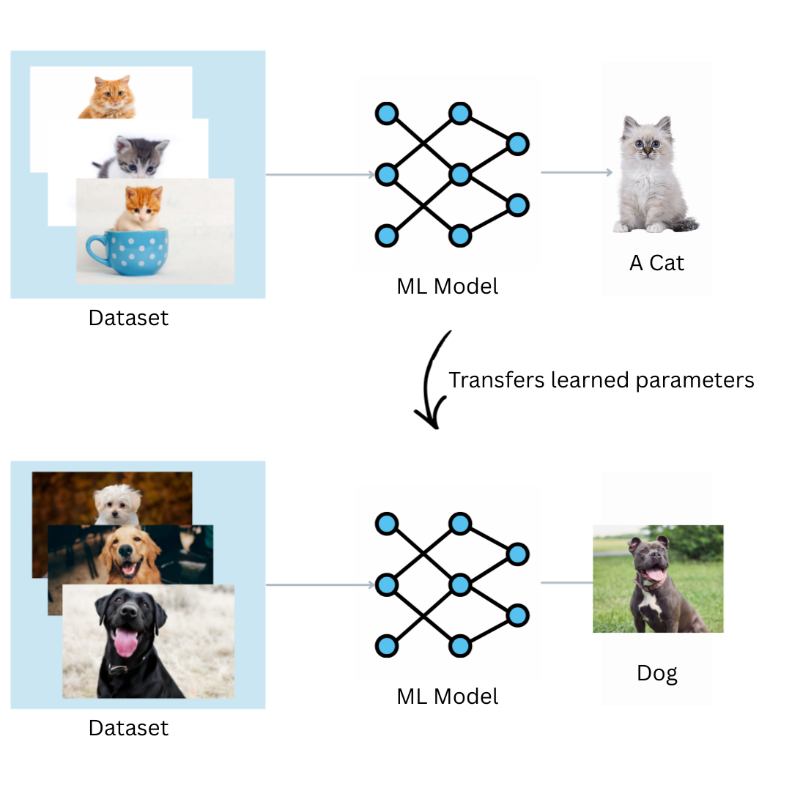
Part I: Foundations and Classical Supervised Learning
Machine learning paradigms
Supervised Learning
Unsupervised Learning
Reinforcement Learning
Semi-Supervised Learning
Deep Learning
Active Learning
Online Learning
Transfer Learning
Involves extracting knowledge from one or more Source Tasks and applying it to a different but related Target Task.
Why do we need Transfer Learning?
Because the target domain often lacks sufficient training data to train a complex model (like a deep neural network) from scratch.

Slide 41
Part I: Foundations and Classical Supervised Learning
Machine learning paradigms
Multi-Task Learning (MTL)
Training a single model to solve multiple distinct tasks simultaneously using shared data representations.
Advantage: Exploits commonalities across tasks, acting as a regularizer to prevent overfitting on any single task
Few-Shot & One-Shot Learning
Utilizing a large training set to learn a similarity function, which is then used to classify entirely new, unknown classes using only 1 (One-Shot) or a few (Few-Shot) examples.
Facial recognition systems, where you provide one photo to your phone, and it learns to recognize you (forever?)

Slide 42
Part I: Foundations and Classical Supervised Learning
Industry Applications Today
Computer Vision
Tasks:
Object detection,
Semantic segmentation
Image generation.
Object tracking
Boundary Mapping
Pose Estimation
Based on Convolutional Neural Networks (CNNs) which handles spatial pixel structures by sharing weights via filters.
Used in:
Autonomous driving
Facial recognition
Automated medical scan analysis (e.g., detecting tumors)
Counting objects

Slide 43
Part I: Foundations and Classical Supervised Learning
Industry Applications Today
Natural Language Processing (NLP)
Tasks:
Machine translation,
Sentiment analysis,
Speech-to-text,
Question answering.
Text-to-speech
Translation
Voice Cloning
Reasoning
Text generation
Techniques:
Word embeddings (Word2Vec)
N-gram models,
Recurrent Neural Networks,
Transformers (LLMs like BERT/GPT).
LLMs, VLLMs
Used in
Chatbots, automated document summarization, virtual assistants

Slide 44
Part I: Foundations and Classical Supervised Learning
Industry Applications Today
Recommender Systems
Main Idea:
To estimate user affinity for products to drive engagement and sales.
Used Today by:
Netflix movie recommendations
Amazon product suggestions
Spotify playlists
Matrix Factorization (factoring a massive User × Item matrix to predict missing preferences).

Slide 45
Part I: Foundations and Classical Supervised Learning
Why Most ML Projects Fail
Misaligned Business Objectives
Not defining what success looks like or misaligning on KPIs, such as focusing on model accuracy over operational impact.

Slide 46
Part I: Foundations and Classical Supervised Learning
Why Most ML Projects Fail
Misaligned Business Objectives
Organizational and Cultural Misalignment
A disconnect often exists between data scientists and business stakeholders

Slide 47
Part I: Foundations and Classical Supervised Learning
Why Most ML Projects Fail
Misaligned Business Objectives
Organizational and Cultural Misalignment
Unrealistic Expectations
Overpromising on the capabilities of AI; leads to disappointment when models cannot deliver immediate, perfect results

Slide 48
Part I: Foundations and Classical Supervised Learning
Why Most ML Projects Fail
Misaligned Business Objectives
Organizational and Cultural Misalignment
Unrealistic Expectations
High Costs and Underestimated Resources
When costs (data, infrastructure, labor) outweigh the projected ROI, projects are often terminated.

Slide 49
Part I: Foundations and Classical Supervised Learning
Why Most ML Projects Fail
Misaligned Business Objectives
Organizational and Cultural Misalignment
Unrealistic Expectations
High Costs and Underestimated Resources
Lab vs Real World!
Many models work well in a lab environment but fail to woefully in production

Slide 50
Part I: Foundations and Classical Supervised Learning
Overview of the Course Project
Project Overview & Objective
Frame a vague or complex real-world challenge as a formal machine learning task, build a reproducible ML pipeline, and rigorously evaluate your solution while acknowledging ethical and practical limitations.
The problem of choice should relate to a personal experience, a challenge within your local community, or an environmental issue.

Slide 51
Part I: Foundations and Classical Supervised Learning
Overview of the Course Project
Project Overview & Objective
Frame a vague or complex real-world challenge as a formal machine learning task, build a reproducible ML pipeline, and rigorously evaluate your solution while acknowledging ethical and practical limitations.
Scope:
Your project must integrate multiple facets of practical machine learning, including
data preprocessing,
baseline establishment,
algorithm implementation,
regularization,
model selection,
error analysis
Team Size:
You will work in small groups of 5 students.

Slide 52
Part I: Foundations and Classical Supervised Learning
Lab
Setup coding Environment
Google Colab
Anaconda environments

Slide 53
Thank you.
Questions?

